Slide 1
Get staff back to work safely: the approach and tools
Presenters: Luis DeSouza, Jason Jenner
Steve Corkin
Thursday 28th May, 11am BST

Slide 2
The Industry Perspective
The Immediate Issues
The Medium Term (Pre Vaccine)
The Longer Term (Post Vaccine)
reduced density, so between 30% and 60% of staff are likely to be in the office
the creating of teams or functions who will work on different days
office design will shift its focus from open plan collaboration to a more segregated setting
visitor and staff site access to be enhanced for social distancing and greater vetting/security.
office working based around activities
new space metrics developed, to support significant home working
rethinking of space types and overall corporate footprint
fully developed home working and related HR policies
staff wellbeing high on the corporate agenda, C Suite topic
better integrated technology for collaboration and space booking
new perspectives on leases and longer-term space demand.

Slide 3
Homeworking, the new reality
80% of staff told a recent survey that safety was their top priority
75% of workers said they felt trusted working from home
68% said they were at least as productive, if not more
Less than 50% felt we would not return to the old normal
Challenges exist with both technology and wellbeing, among other things.
So, what is the key message? Employers will need to re visit
home working, a new level of flexibility will be required, and
staff will expect to be engaged on various matters in the
process of returning to work.

Slide 4
Technology and the transition to safe working

Slide 5
Key topics to address on back to work safety
Digital signage can be adapted to better inform on space and key messages
Planned hot desking use, adopt a group policy to minimize risk
Remote work where possible, use collaboration tools.
Social distancing
Enhanced hygiene measures
Staff to use personal devices like mobiles to plan an office day
NFS have created a summary Compliance Guide, to be provided as one of the Webinar documents.

Slide 6
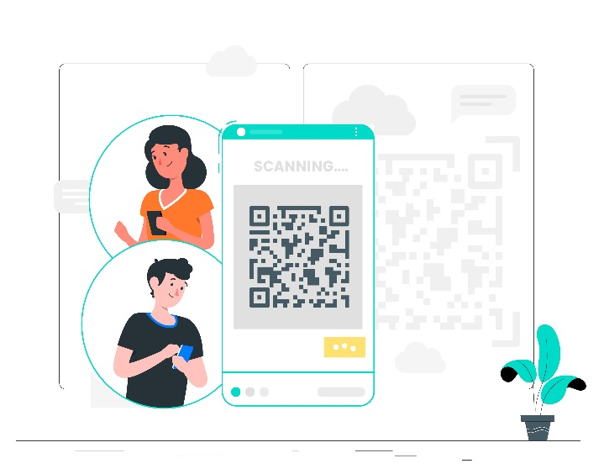
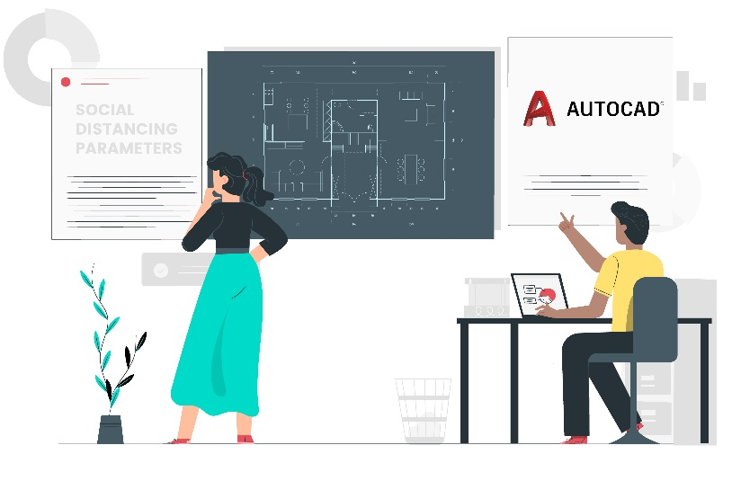
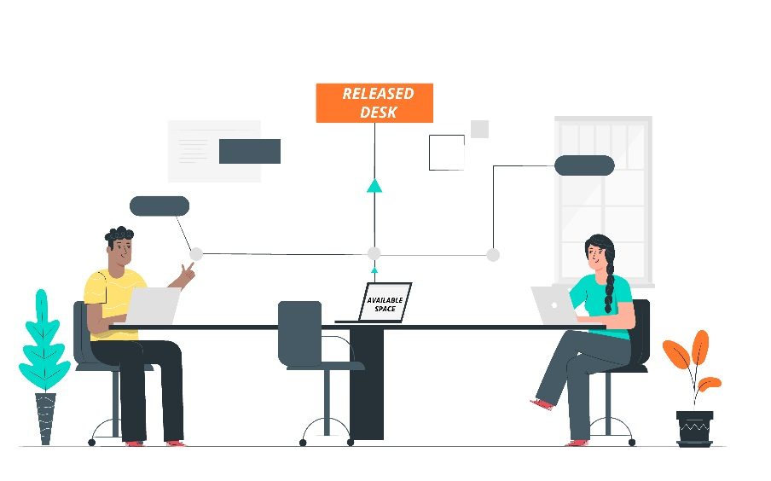
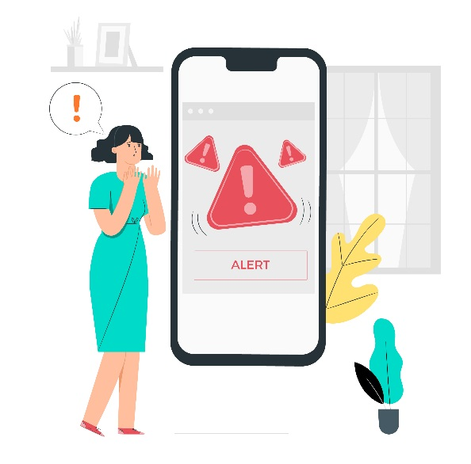
Key elements of the NFS Solution Set
Mobile Space Booking
Social Distancing Planning
Zero Touch Access
Compliance/Analytics
Reverse Hoteling
Service Alerts

Slide 7
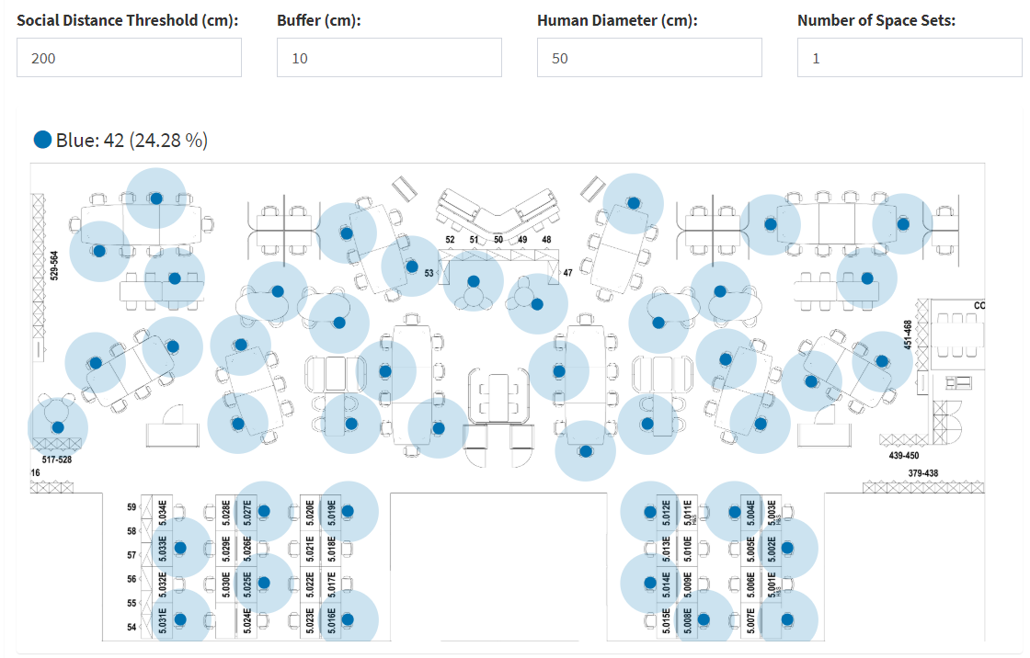
Social Distancing Planning

Slide 8
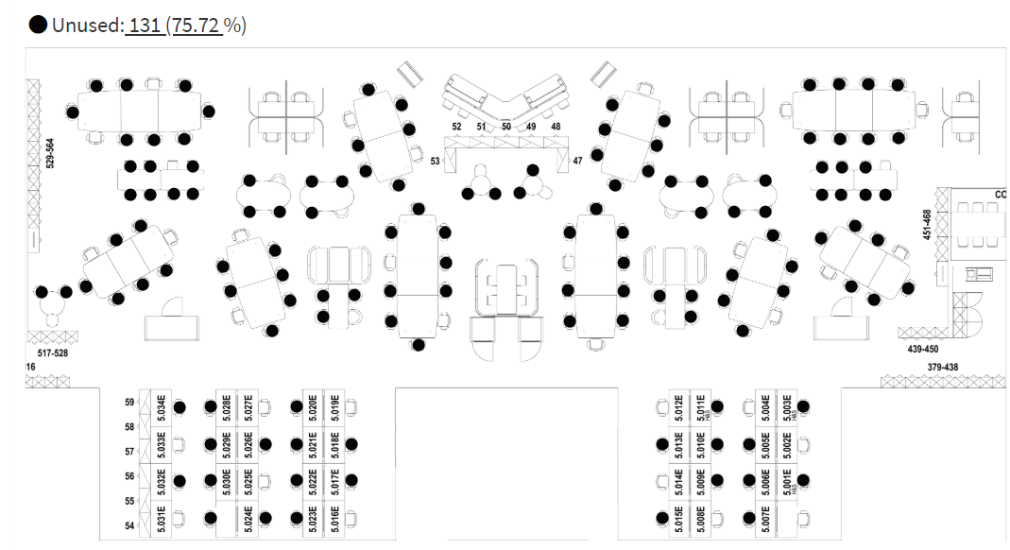
Social Distancing Planning continued

Slide 9
Demonstration of Mobile Space Booking
Planning a day in the office from home
Booking a safe space to work is critical
Need to know that space booked will comply with social distancing rules
Confirmation of space and related conditions available in good time
Notifying the facilities when I’ve arrived and departed for the day

Slide 10
Booking Desks, Rooms & Services
Securing the right desk, near my colleagues
A suitable meeting room, but where
reduced capacity needs to be observed
visitor needs to be booked in safely
collaboration for external attendees
Services like Catering to be delivered safely
Set up and clear up times extended to
allow for cleaning and safe access.

Slide 11
How can Zero Touch become a reality
QR code scanning to check in and out of desks or meeting space
RFID personal access cards for secure room access, check in and out and meeting initiation
Automated messaging to service providers to clean rooms or deliver services
To be released shortly will be QR codes for visitors, to allow access to the building with Zero Touch registration
Visitor pre notification to minimize face to face contact.

Slide 12
Analytics/Compliance Monitoring
Number of people in a meeting room —room-based sensing is an option
Carefully monitor desk occupancy levels, by area, building and space type
Total number of people in a building or space—will require sensor technology
Mobile apps to register presence could be used to support track and trace
Instigate fixed team days—this reduces density and reduces risk
New staff roles to monitor social distancing?

Slide 13
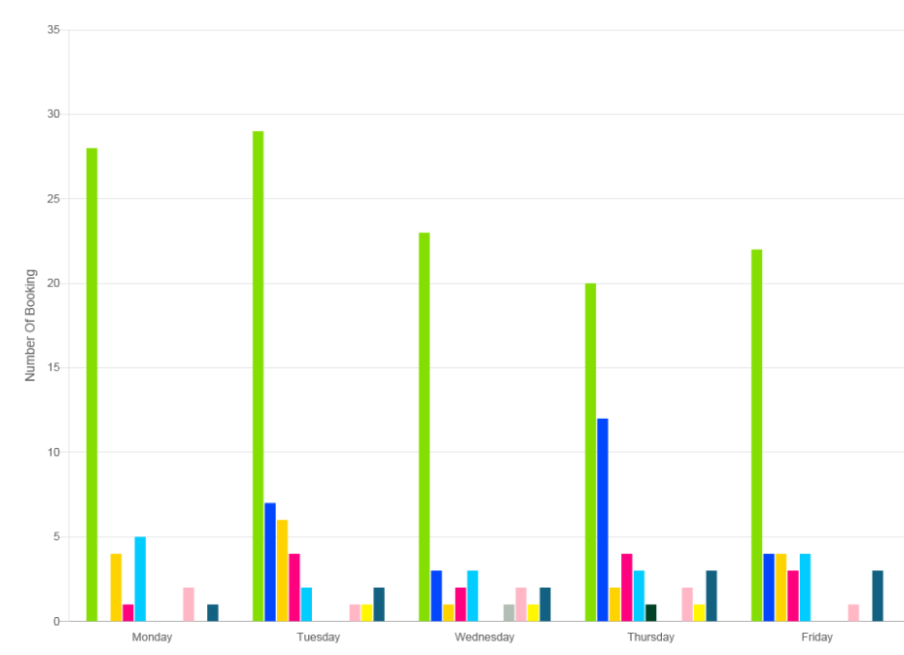
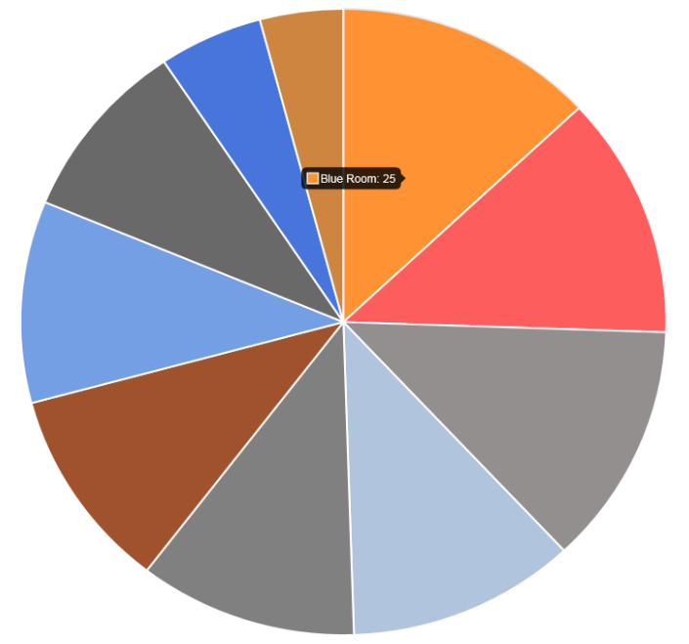
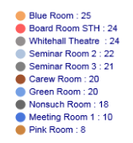
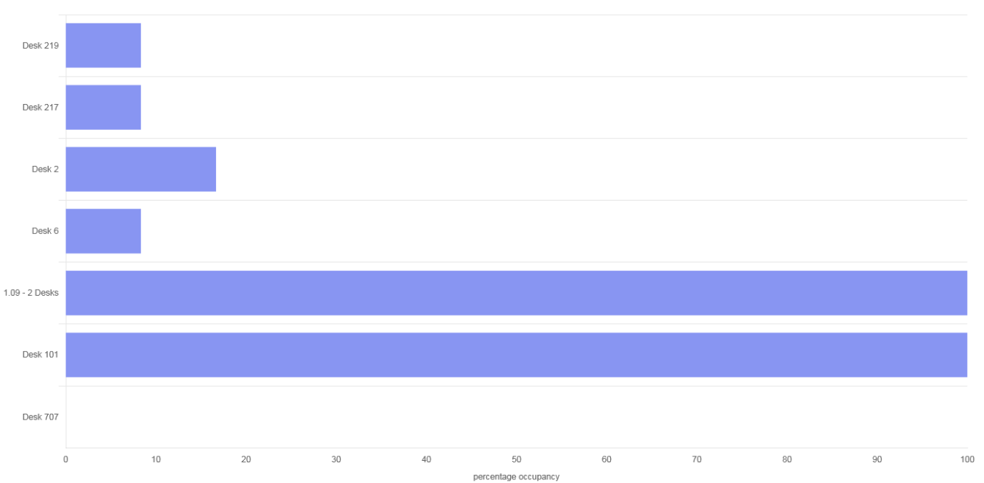
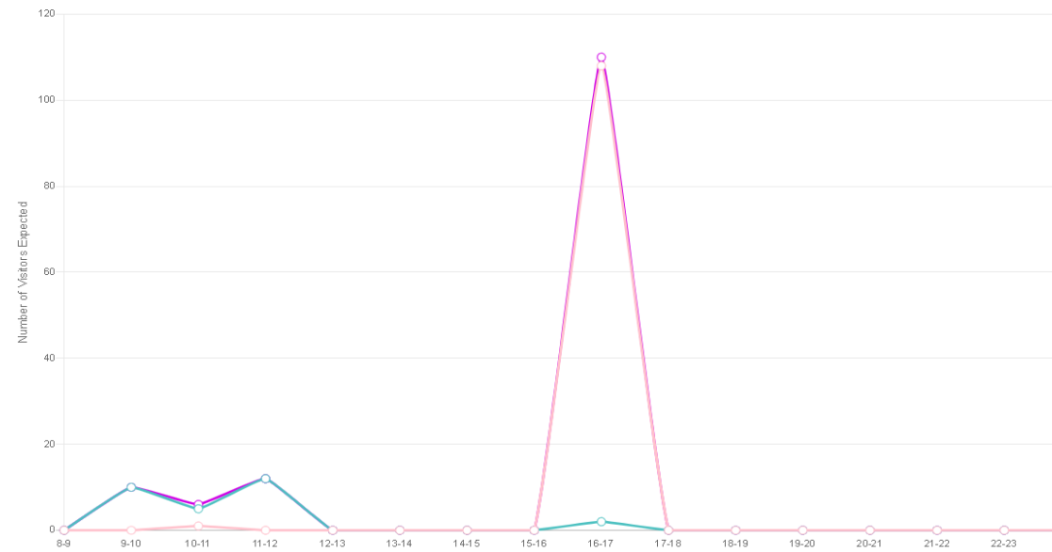
Dashboards
Top 10 – Most used Rooms
Booking count based on number of participants per booking
Visitor Numbers Expected By Arrival Time (identifies busy times of the day)
Percentage Occupancy (Desks) - Today

Slide 14
Compliance Monitoring

Slide 16
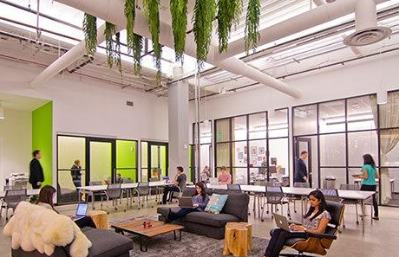
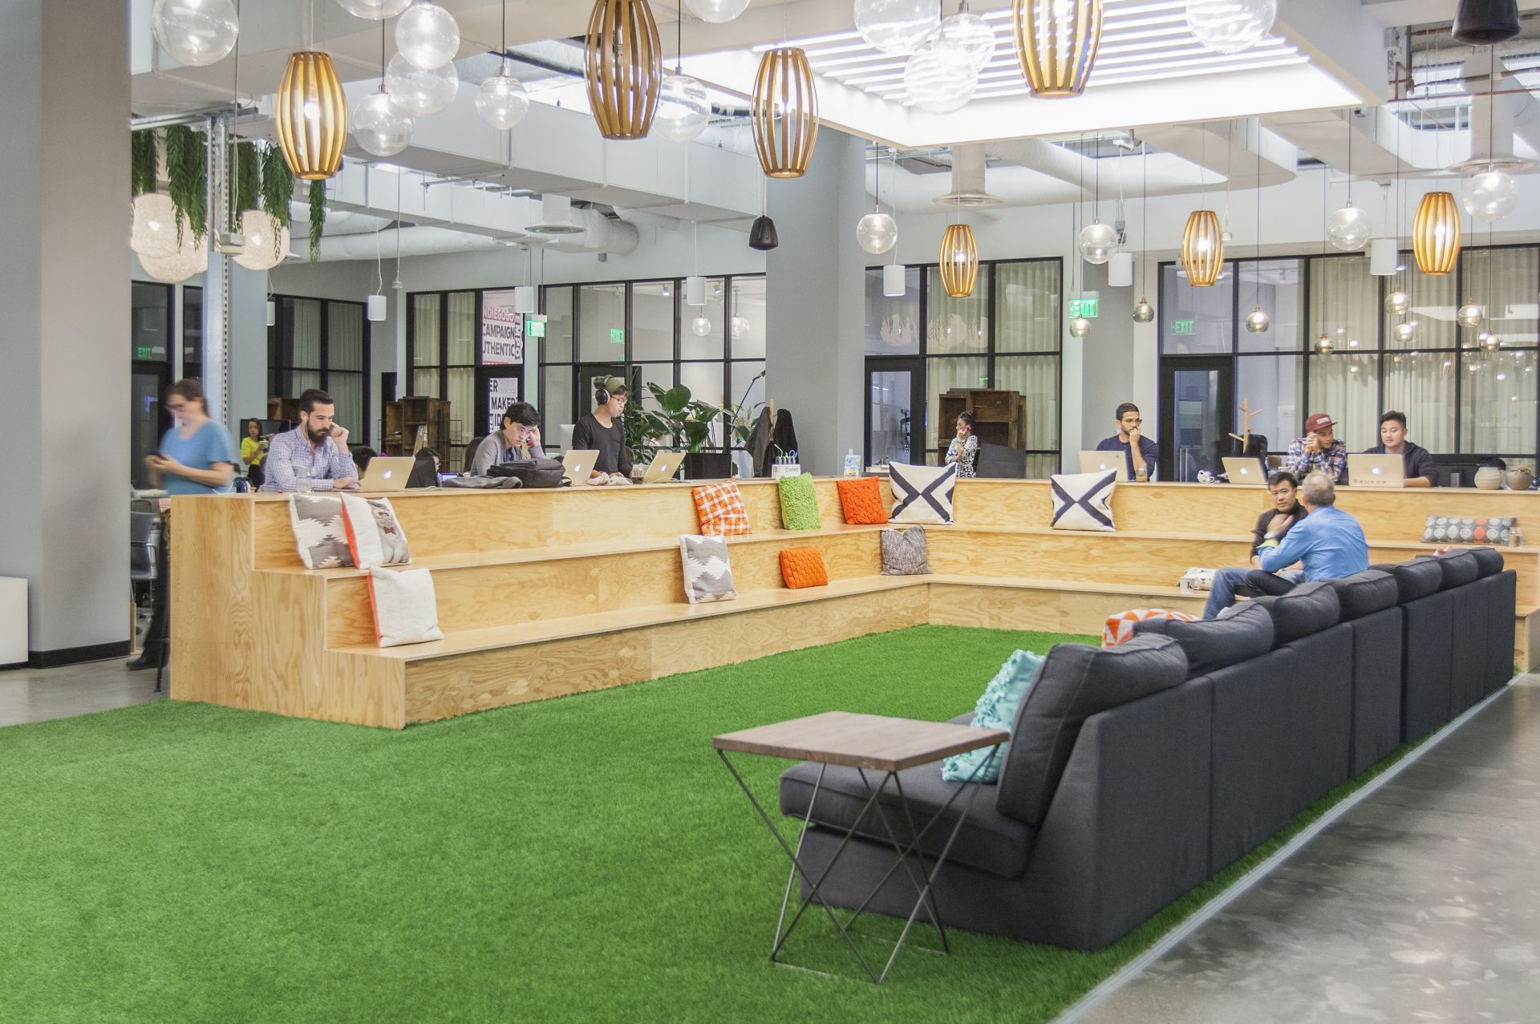
The New Normal—Predicted Key Drivers
Greater flexibility in terms of the home/office balance
Increased use of mobile apps to support planning a day at the office
The Booking system will be set up to apply appropriate business rules, including social distancing
More data will be available on how space and buildings are used, based on a range of sensing technologies
Better data will drive smarter decisions on real estate footprint as well as space type
Potentially a hybrid model will emerge combining a smaller main office, home working, using local facilities and team meetings with a small number of people in a single location.
Trends will not change, history tells us that disruptive events accelerate existing trends and also lead to new behaviours, COVID-19 is doing exactly this.

Slide 17
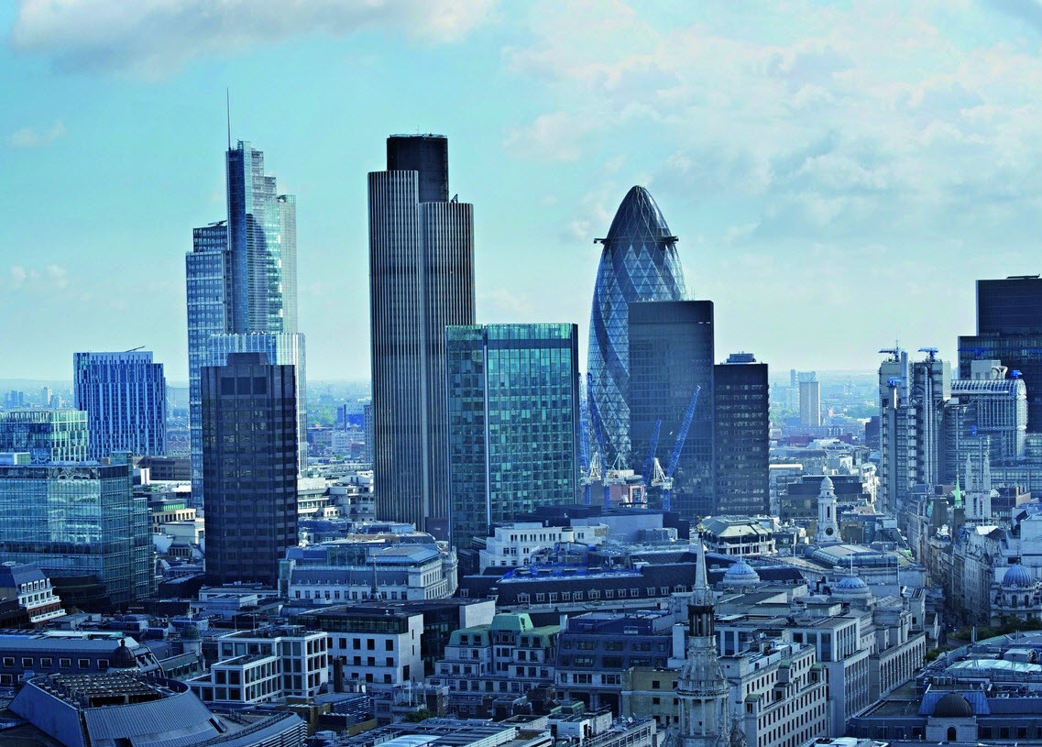
Thank you
Q&A
Website: myrendezvous.net
Email: info@nfstechgroup.com
Tel: +44 800 731 8451
Notes:
E: info@nfstechgroup.com
T: +44 800 731 8451

